Slide 1
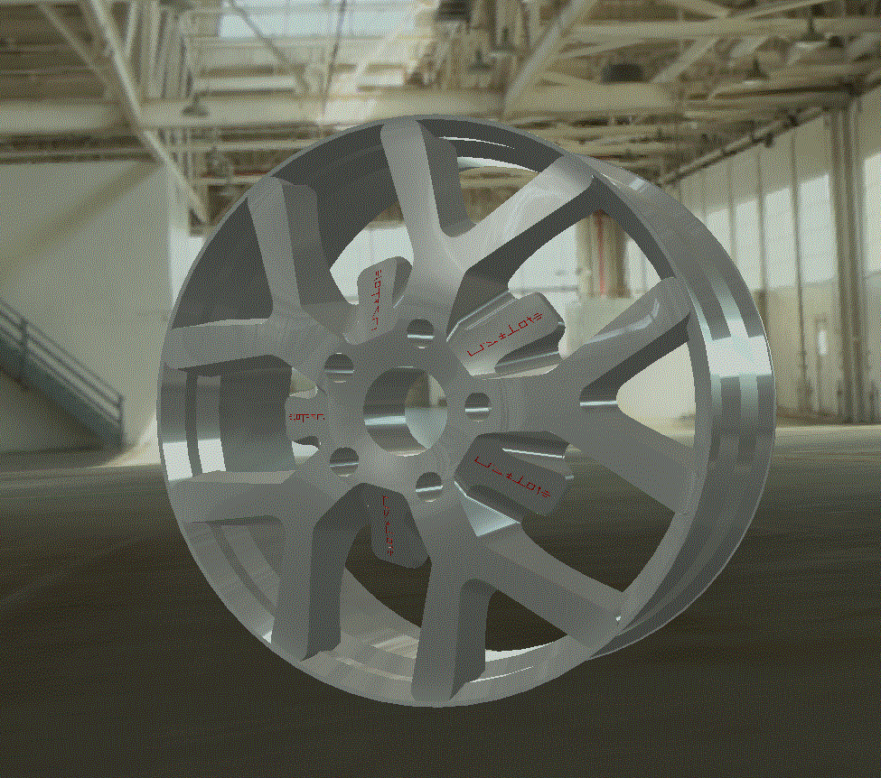
Lesion 7 Advance pattern operation
LAB 06 (Wheel)
IDE 33101CAID Dr. Palang WONGTANASUPORN lecture 10-11
17” Rim
Step by step
reveal

Slide 2
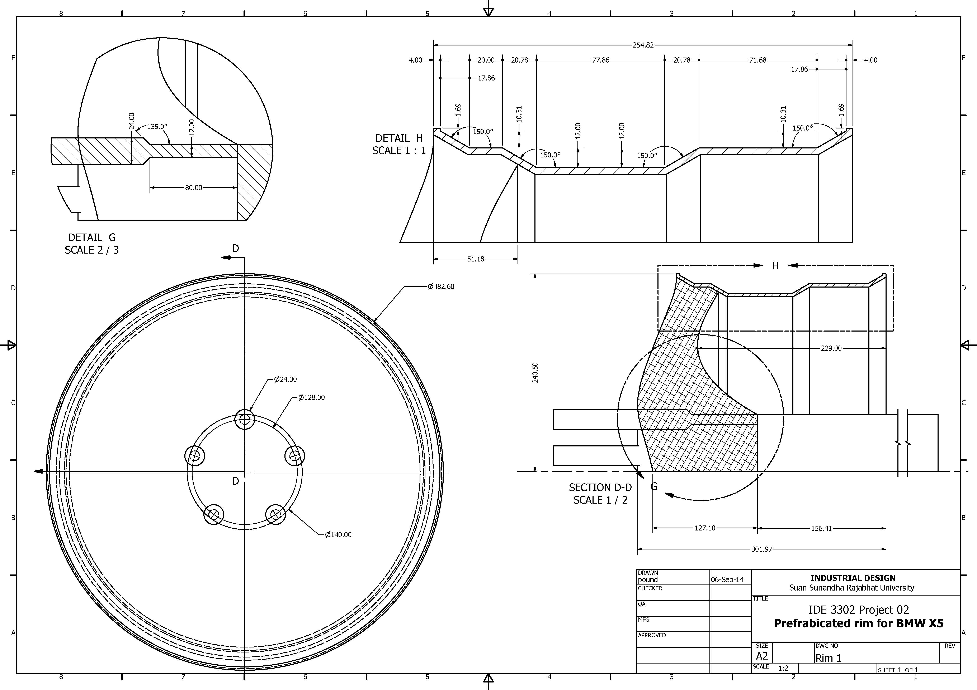
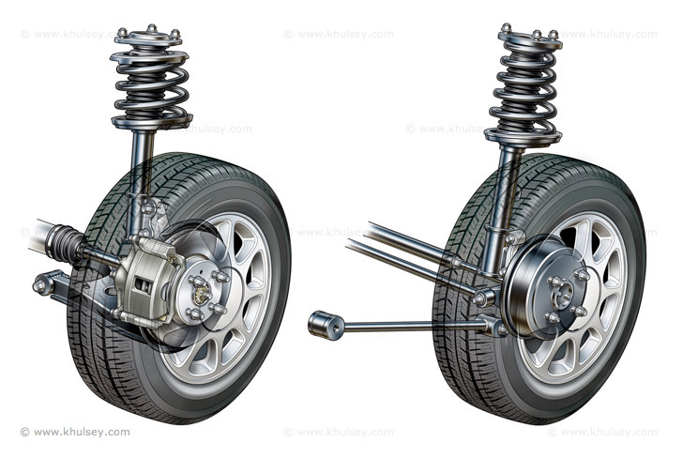
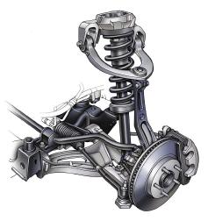
Preparation
Your own design wheel
Standard size of a blank rim
Standard size and position of
connector and nuts

Slide 3
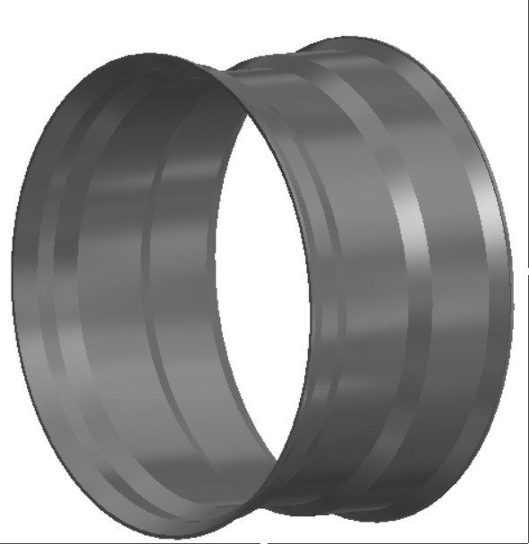
Rim body
Set sketch view as xy plane
Use X axis as rotation axis
Draw cross-section of rim
Turn on Revolve operation
Revolve profile 360 degree

Slide 4
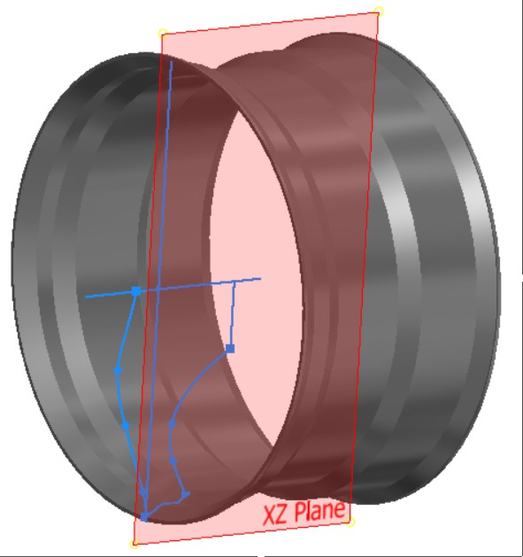
Front plate
Use XZ plane as working plane
Create profile sketch for revolve
Make sure the rotation axis is the same with rim ( x axis)

Slide 5
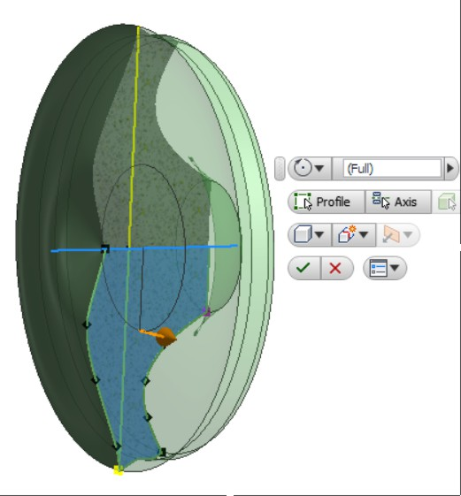
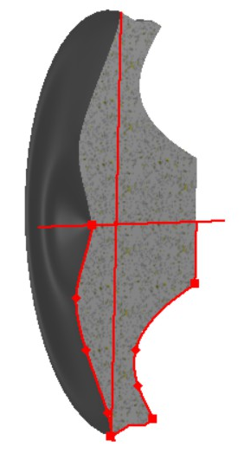
Revolving front plate
Turn on revolve operation
Select cross section as profile
Rotate 360 degree

Slide 6
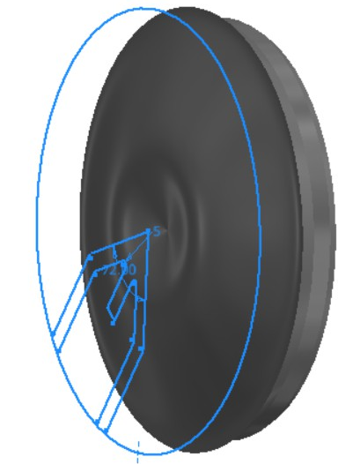
Pattern sketch
Create a work plane over YZ plane
Sketch a main pattern for cut off the front plate
Make sure the sketch will complete the close loop of circle after circular pattern operation

Slide 7
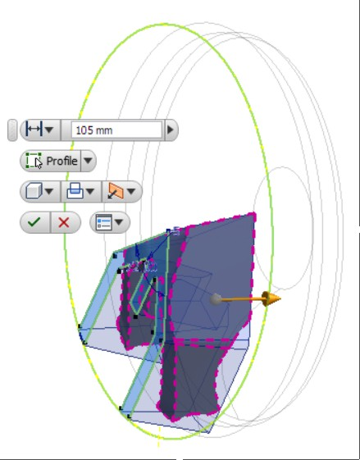
Make extrude part for circular pattern
Turn on extrude operation
Select close loop section as profile
Extrude (intersect)
Click OK

Slide 8
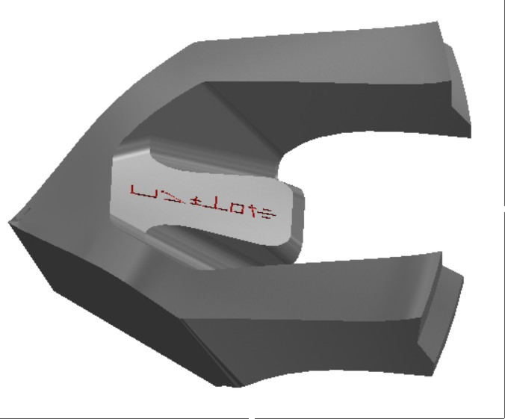
Redefine extruded part
The extruded part need to be redefine
Modify operation such as Chamfer Fillet Draft may be concerned

Slide 9
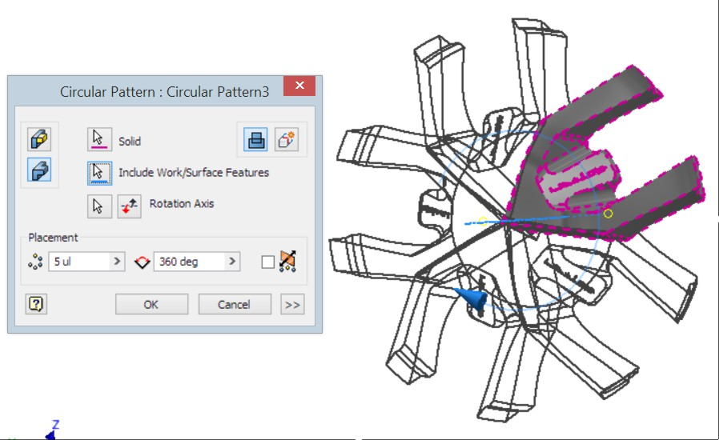
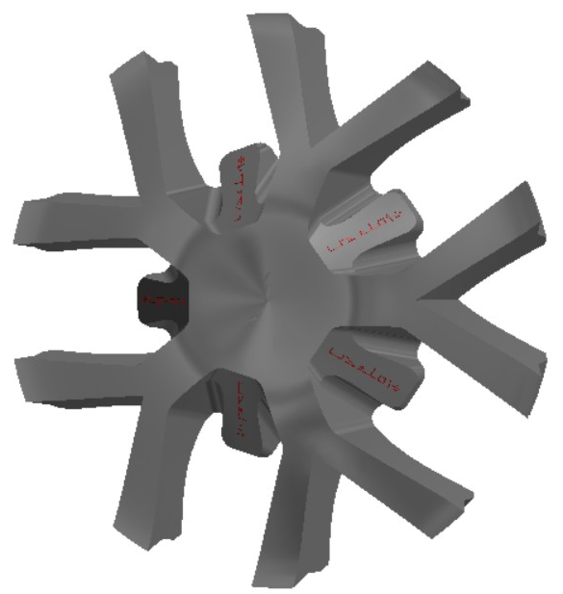
Turn on Circular pattern operation
Select extruded part as solid
Set placement as 4 at 360 degree
Click OK

Slide 10
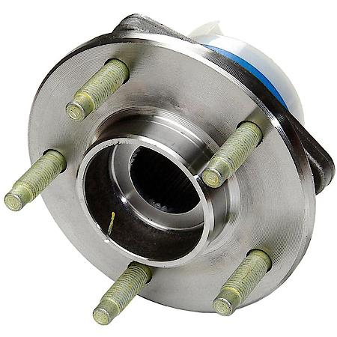
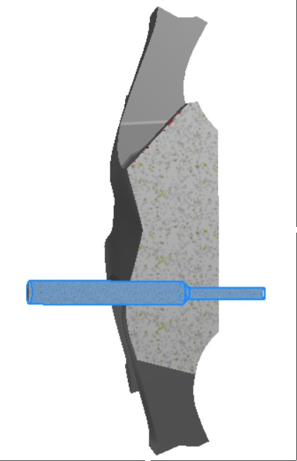
Socket rod
Create socket rod for screw shaft and bold spacer
You need to make position for a hold then create socket rod by using revolve operation

Slide 11
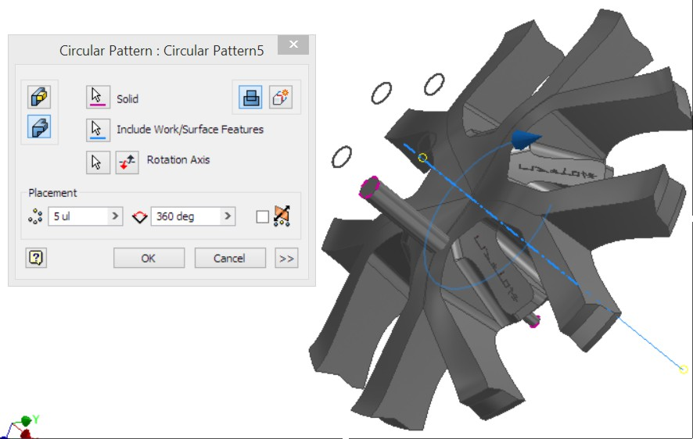
Hold Pattern
Use circular pattern to arrange other socket rod

Slide 12
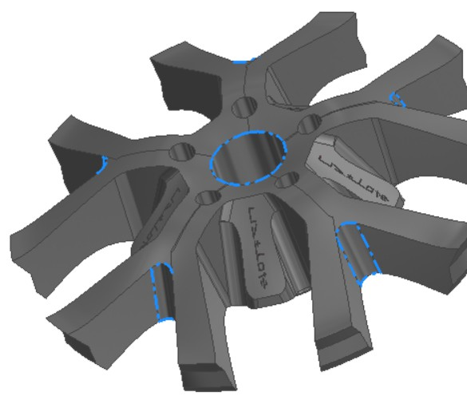
Redefine the front plate
Redefine the front plate especially the sharp edges after pattern operation and also reduce unnecessary part

Slide 13
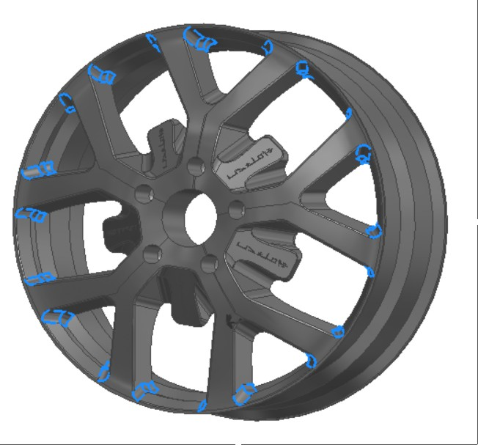
Assembly
Combine front plate and rim
Redefine the sharp edges after combined

